Slide 1
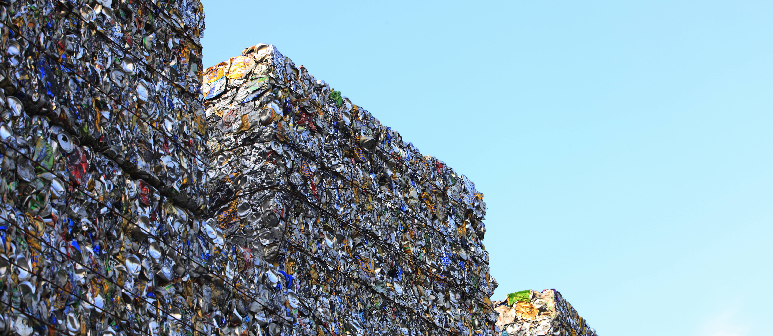
PLAGAZI – GREEN HYDROGEN FROM WASTE
MAY 2021
®

Slide 2
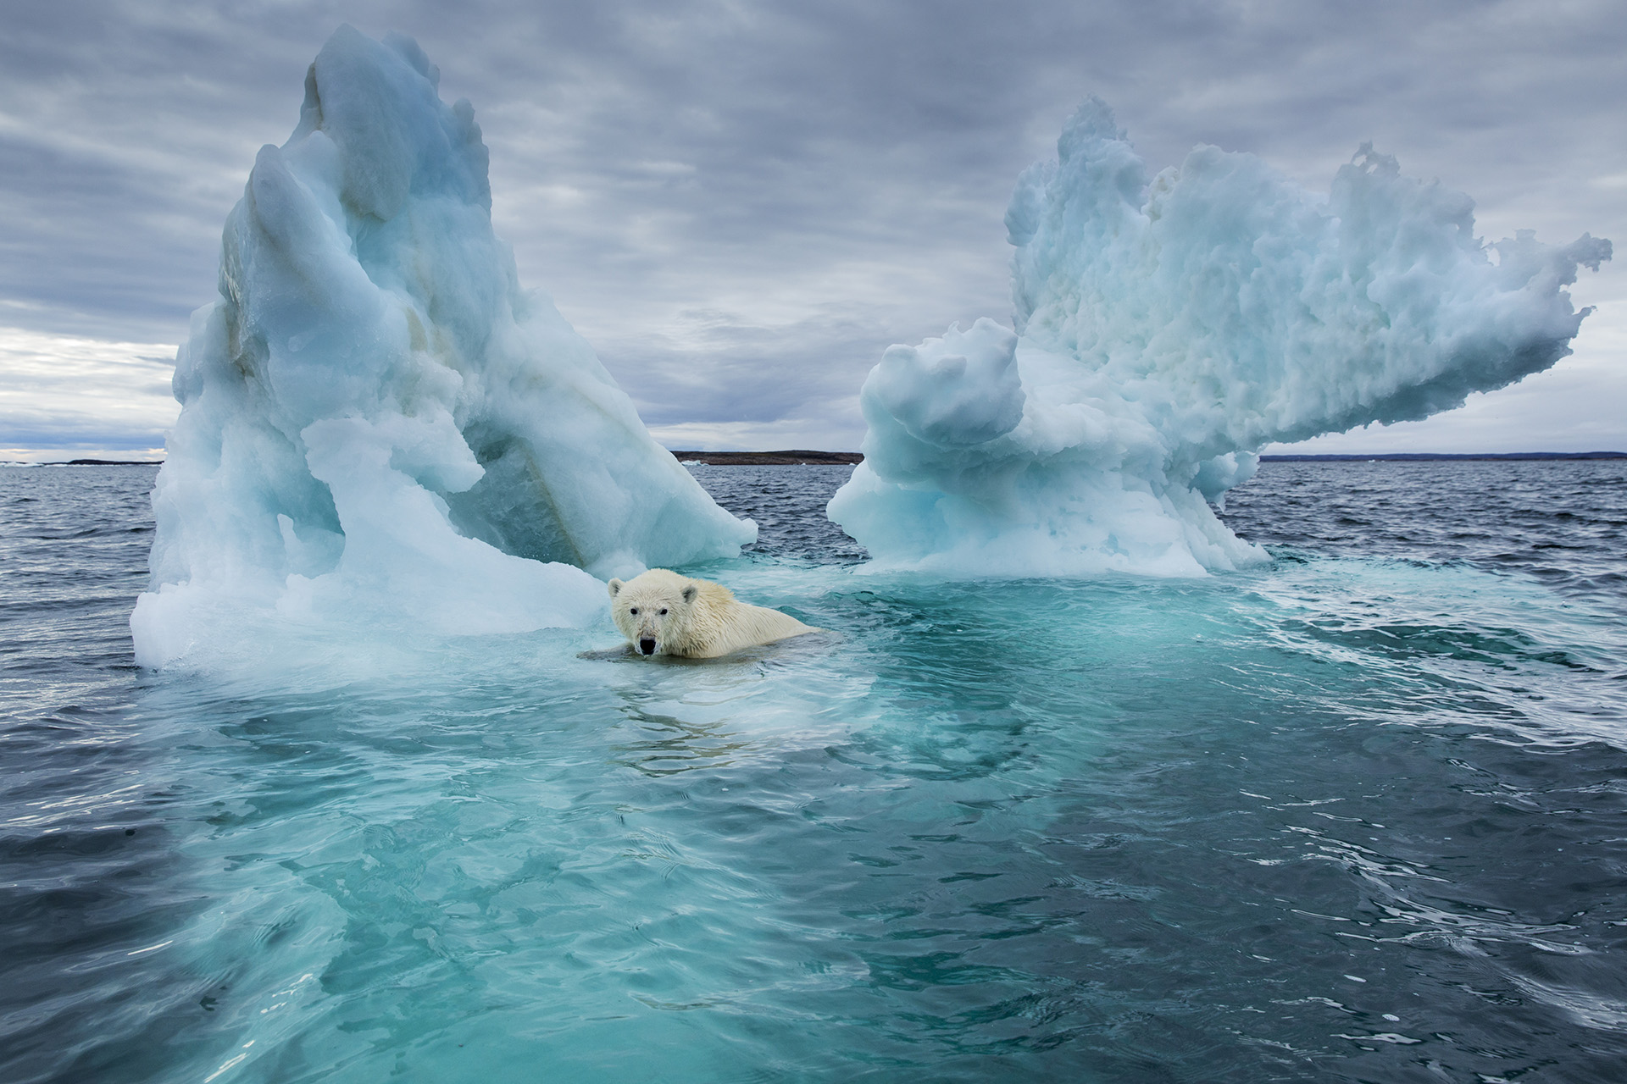
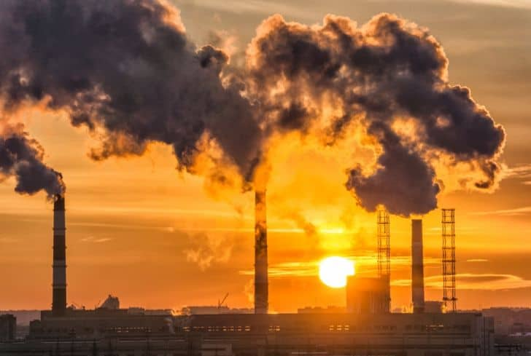
WHY PLAGAZI?

Slide 3
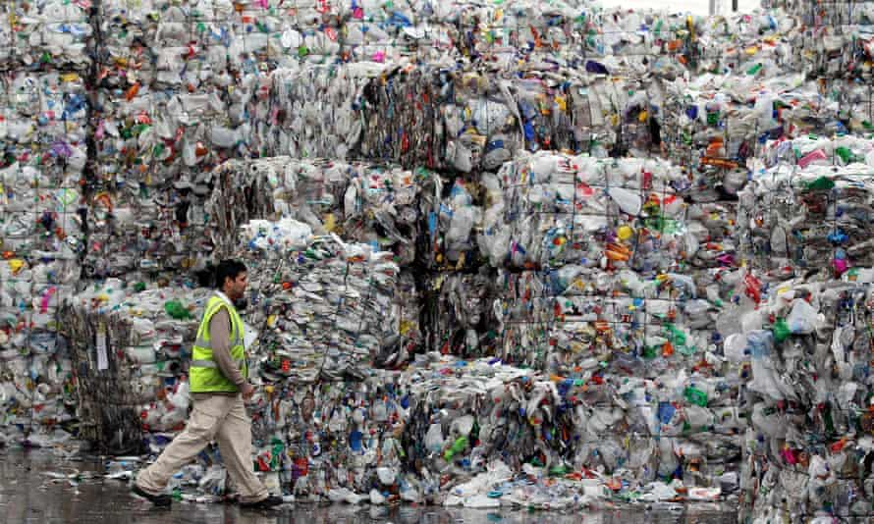
70% increase
by 2050
2 billion
tons per year
Saint Petersburg
Lisbon
PER DAY!

Slide 4
WHY PLAGAZI?
SOLUTION
Renewable Energy Sources
Improving our circular economy and waste management issues
Unrecyclable waste into pure green hydrogen

Slide 5
THE CIRCULAR ECONOMY
H2
RESOURCE
MANUFACTURING
Manages all types of waste:
Auto shredder residues
Medical waste
Plastic waste
Industrial waste
PLAGAZI PROCESS
RECYCLING
WASTE
CONSUMPTION
& USAGE
®

Slide 6
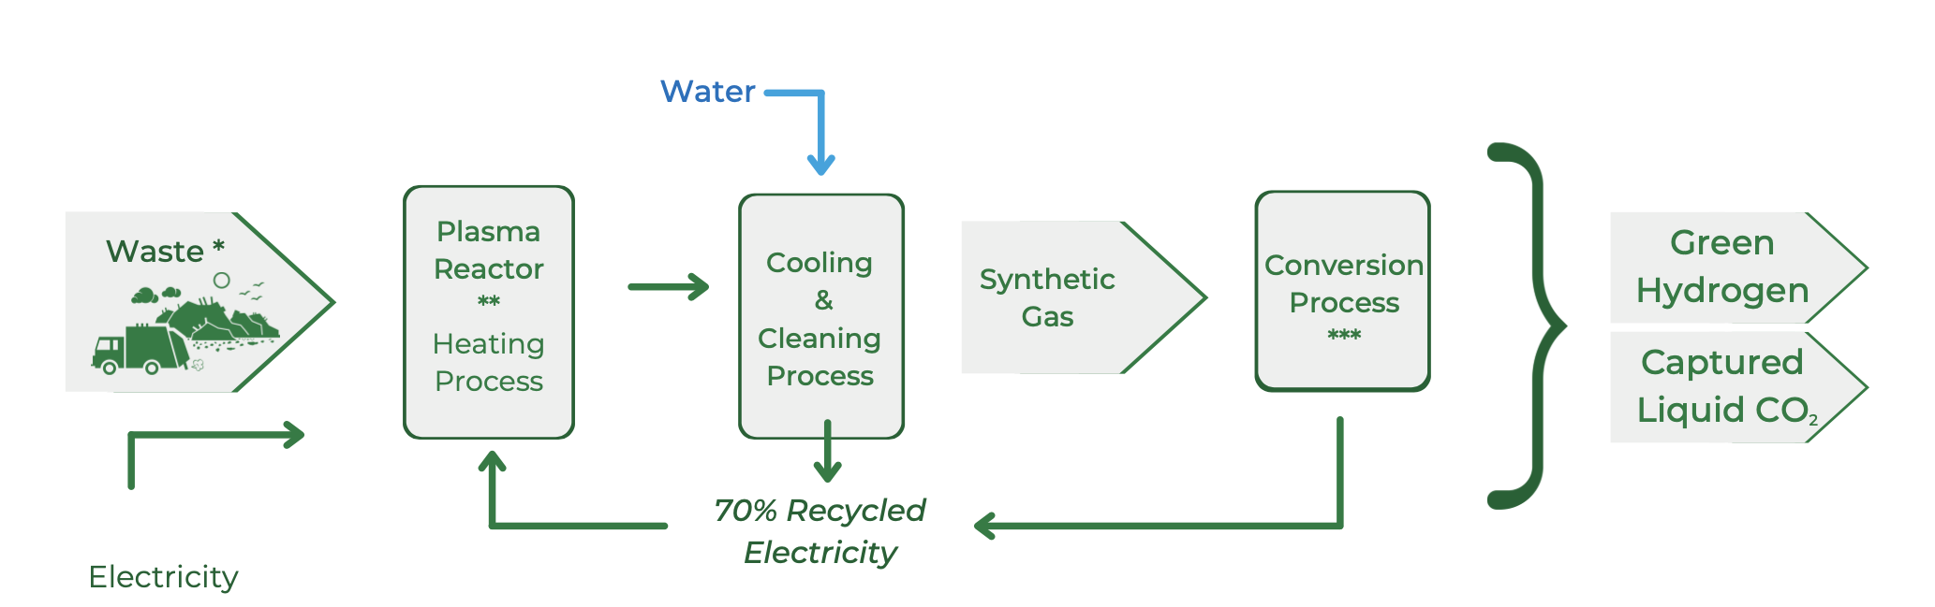
THE PLAGAZI PROCESS

Slide 7
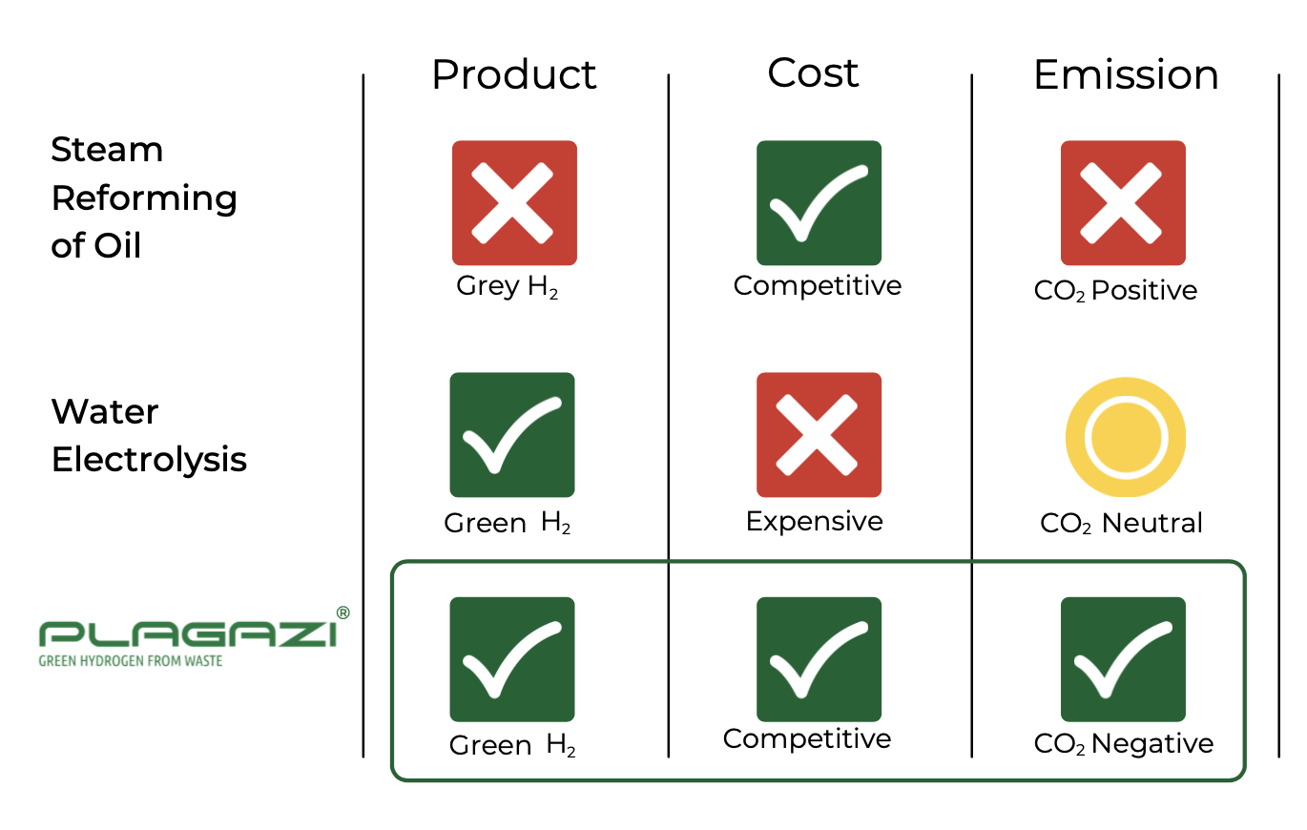
GREEN HYDROGEN PRODUCTION:
De-carbonazing our environment by removal of unrecycable waste

Slide 8
BUSINESS CASE EXAMPLE: Customer Point of View - One HE6000 Plant:
BUSINESS CASE DETAILS:
CUSTOMER FINANCIAL OUTCOME:
5-6 Years Project Breakeven
65 % Avg. EBITDA Margin
€70 m ROI (excl. investment)
100%
ROI %
Plastics
Type of waste
40 000 ton
Amount of waste p.a.
6 000-ton H2
Yearly production capacity
CUSTOMER PROFILES:
€5.5/kg Hydrogen Price
€0.03/kg Waste Gate Fee
€40/ton
Cost of Carbon
Capture System
€2.8/kg Production cost
Customers where the Plagazi Process would be an upgrade on current processes: i.e. Waste Management, Recycling or Material Processing.
Customers seeking a source of hydrogen: i.e. Energy/Gas Pipeline Companies or Chemical Industries.
Customers seeking a financially attractive method to deal with internally produced waste: i.e. Consumer Good Companies or Heavy Industry.
€70 m PP&E Investment
15 years Project Horizon
50% via Debt
Rest of investment via Equity
5%
WACC
®

Slide 9
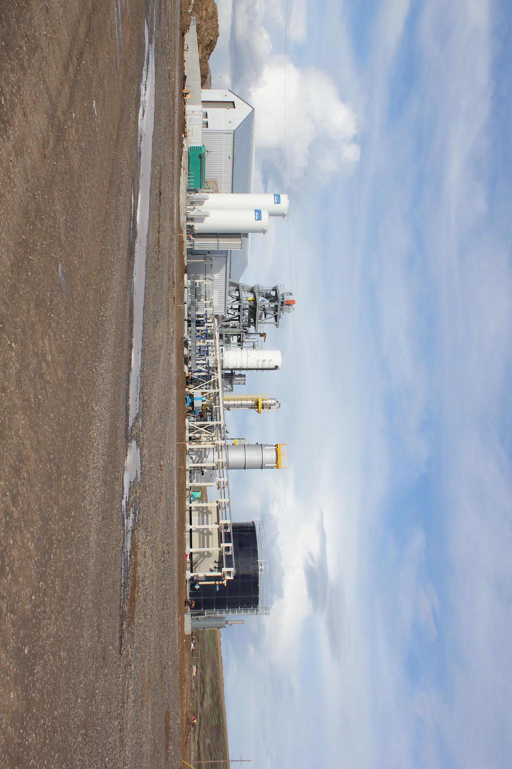
PATENTED TECHNOLOGY & PROOF OF CONCEPT
Plant near Arlington, U.S. | Running since 2011 |

Slide 10
ABOUT PLAGAZI
2007
20+ people

Slide 11
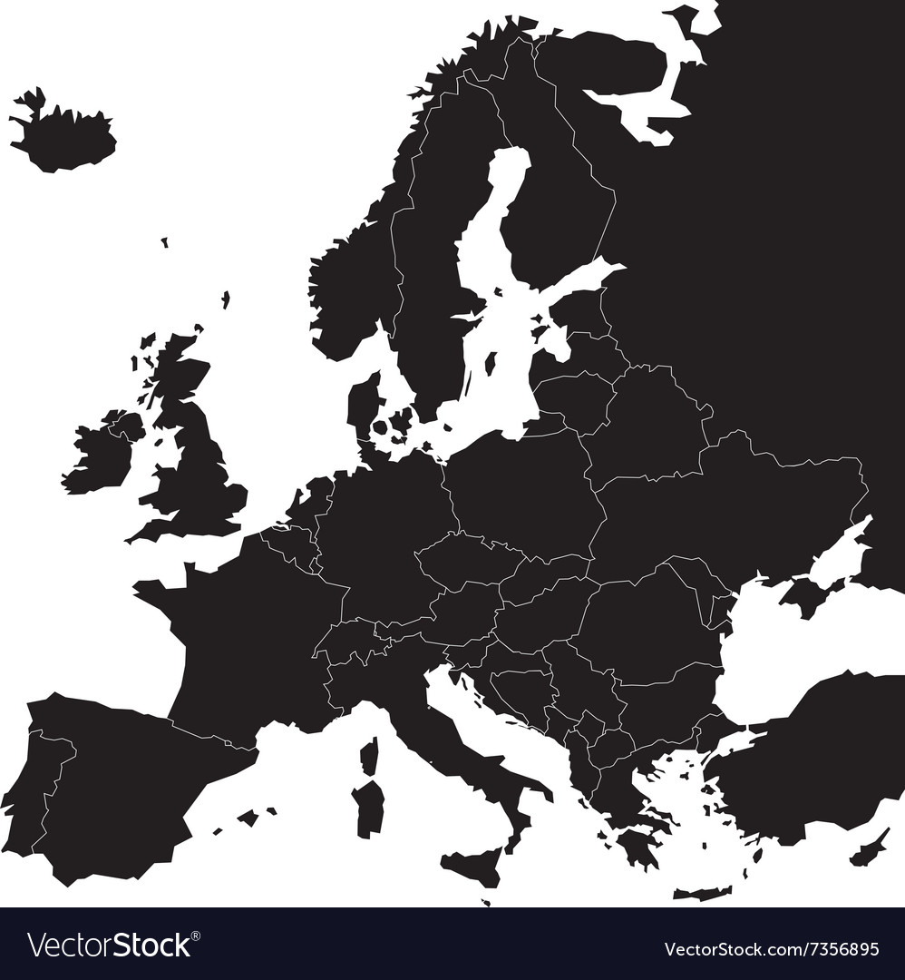
PLAGAZI IN EUROPE
®

Slide 12
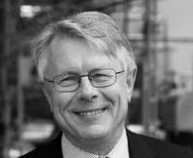
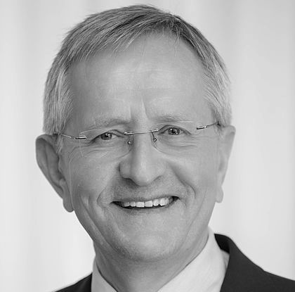
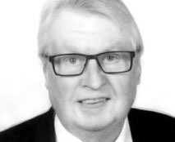
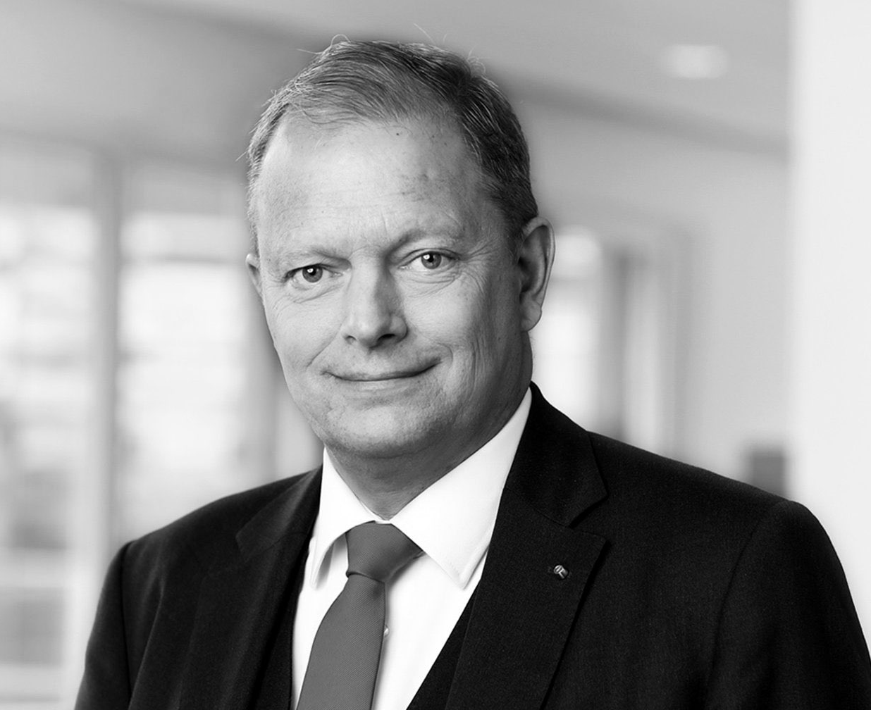
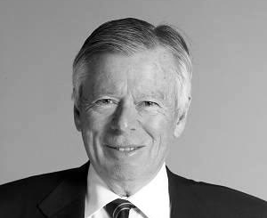
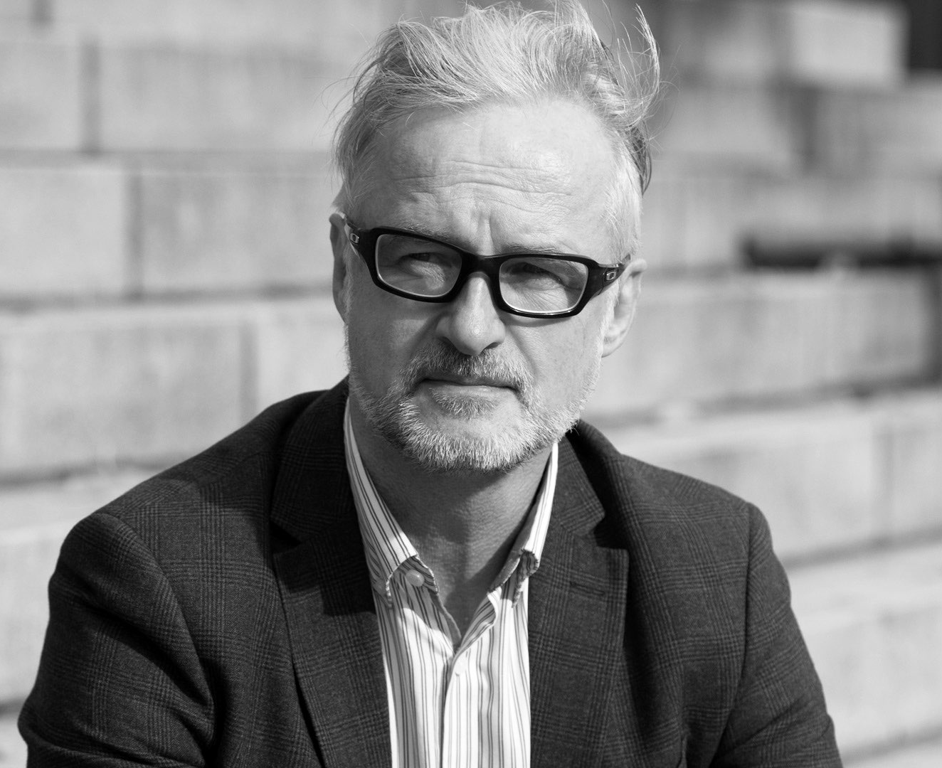
ADVISORY BOARD
Jan Bäckwall,
Former Regional Manager Linde Group
Former CEO of AGA AB
Prof. Dr. Ing. Bernd Meyer,
Germany’s outmost expert on Plasma Gasification
Former Director of the Institute of Energy Process Engineering and Chemical Engineering (IEC) in Freiberg
Jörgen Andersson (Partner),
Chairman of Cindrigo AB
Former Minister of Interior & Energy
Former Chairman of Vattenfall
Tomas Kåberger (Partner),
Chair of Executive Board, Renewable Energy Institute
Member Board of Directors - Vattenfall
Tuve Johannisson,
Former VP Tetra Pak
Former MD Volvo Cars
Jakob Lagercrantz,
Chief Executive Officer & Founder of 2030-Sekretariatet
Managing Director - Equest AB
®

Slide 13
www.plagazi.com
info@plagazi.com
Plagazi
®

